Slide 1
Lecture 8: Visual Encodings
DS 4200
Fall 2022
Prof. Ab Mosca (they/them)
Northeastern University
Slides and inspiration from Cody Dunne, Michelle Borkin, Dylan Cashman, Krzysztof Gajos, Hanspeter Pfister,
Miriah Meyer, Jonathan Schwabish, and David Sprague

Slide 2
Last Class
We:
Worked on D3
Any Questions?

Slide 3
Today
Visual Encodings (for tables)
Sketching new visualizations \ iterative design

Slide 4
Visual Encodings
From Munzner’s book

Slide 5
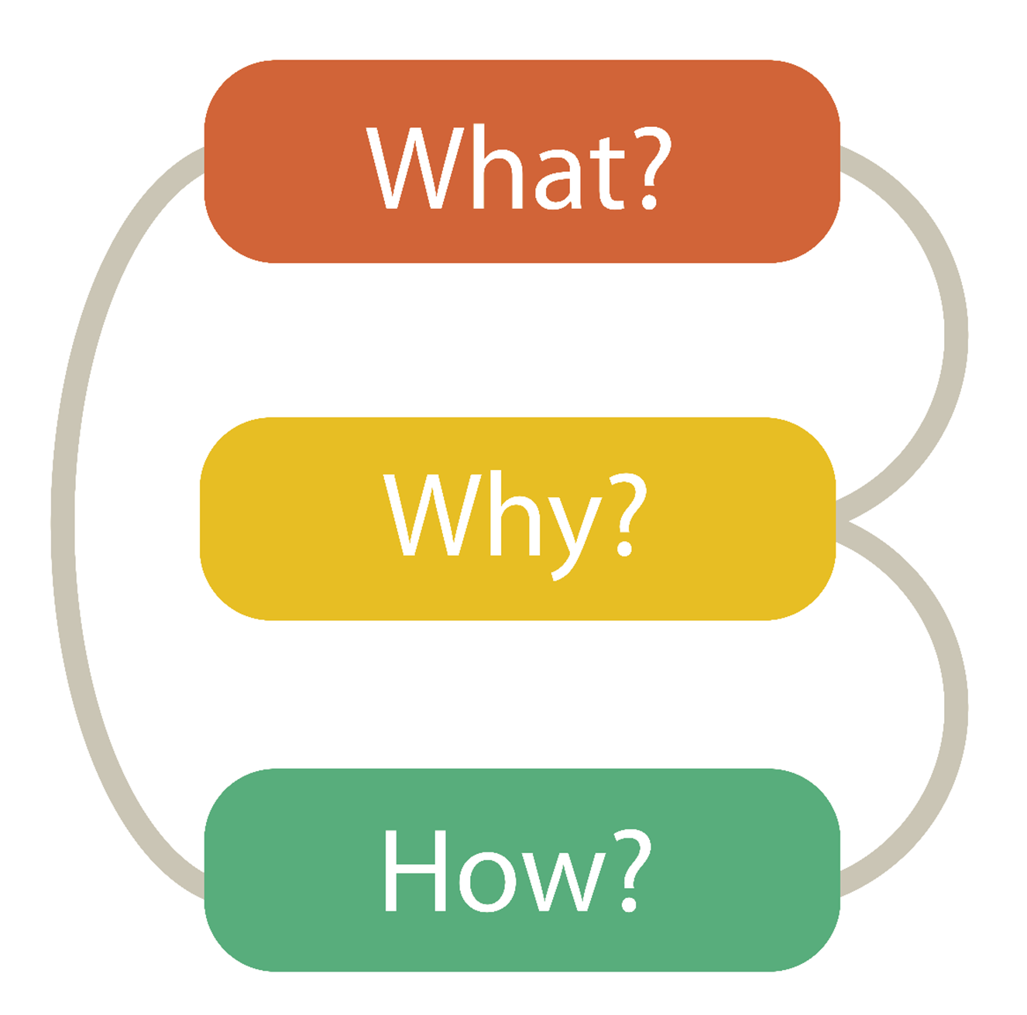

Visualization Building Blocks
Data Abstraction
Task Abstraction
Visual Encoding
Notes:
Munzner’s nested model, what why and how

Slide 6
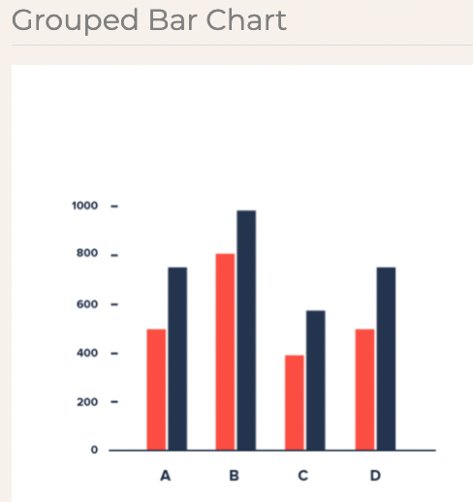
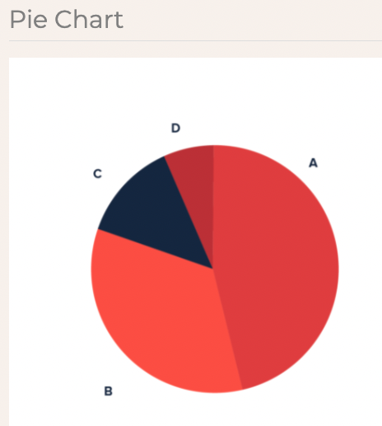
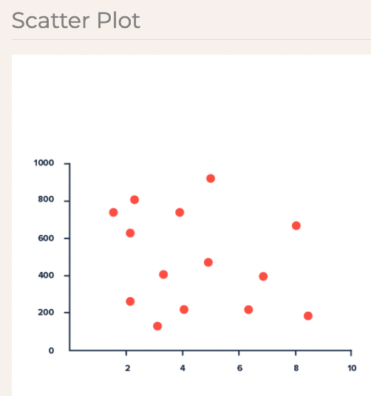
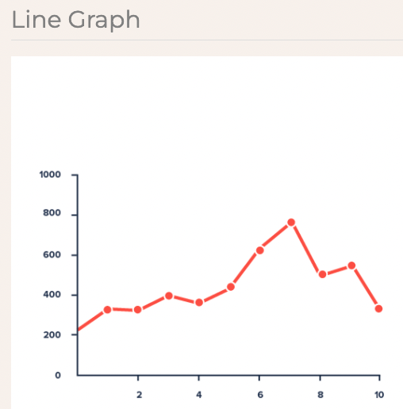
Visual Encoding
What is it?
The literal representation of data in a visualization.
https://datavizproject.com/
Notes:
Previously, we started talking about visual encoding, and defined it as the literal representation of data in a visualization
We talked about how visual encoding refers to basic graphs and charts like these <next>

Slide 7
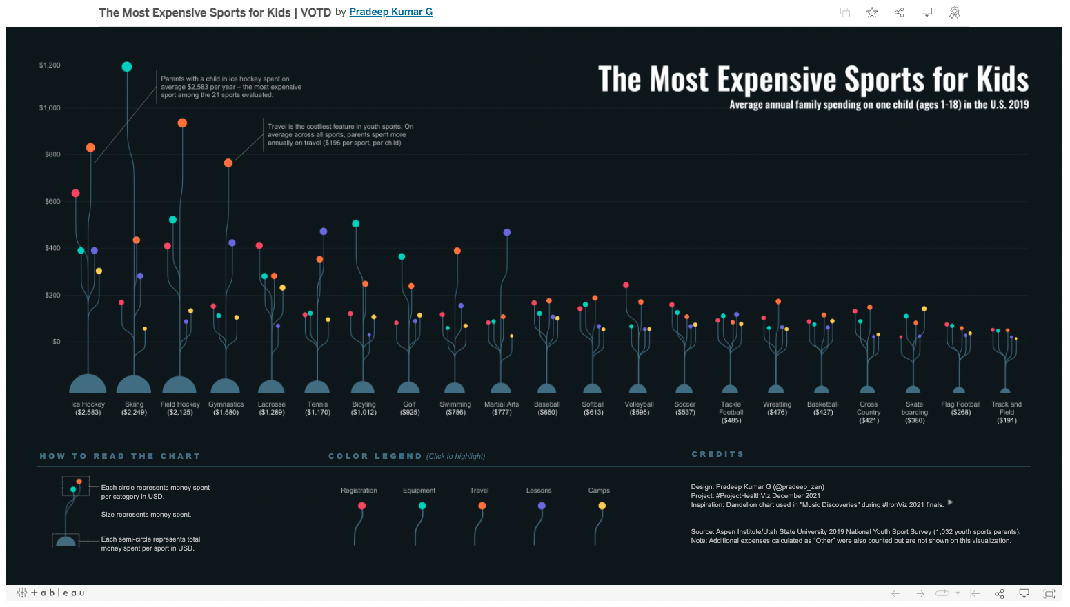
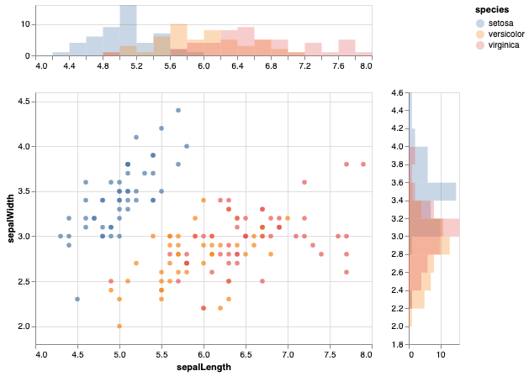
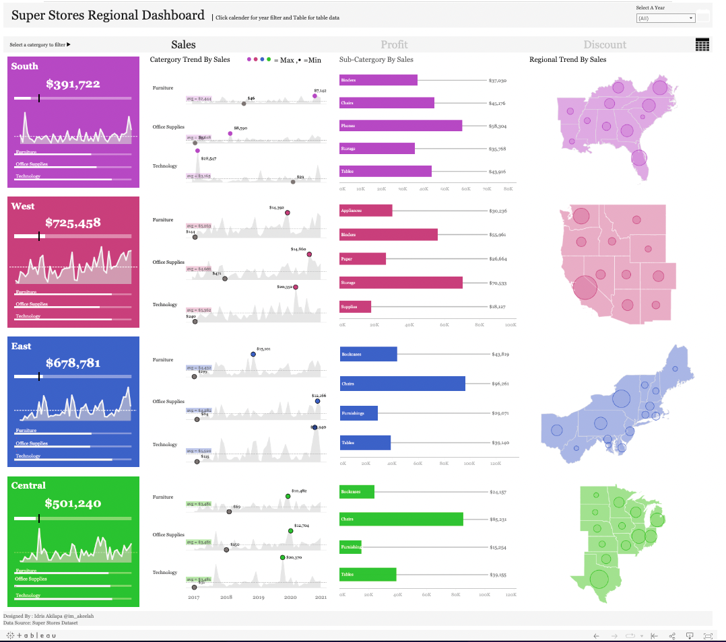
Visual Encoding
What is it?
The literal representation of data in a visualization.
https://altair-viz.github.io/gallery/index.html
https://public.tableau.com/app/profile/pradeepkumar.g/viz/TheMostExpensiveSportsforKids/ProjectHealthViz
https://public.tableau.com/app/profile/akilapa.idris5302/viz/SuperStoresRegionalDashboard/SuperStoreRegionalDashboard
Notes:
As well as to more complex combinations of graphs and charts like these.

Slide 8

Marks and Channels
Marks and Channels = basic visual primitives that make up visualizations
Mark = basic graphical element in an image
Channels = ways to control the appearance of marks
Notes:
Read

Slide 9
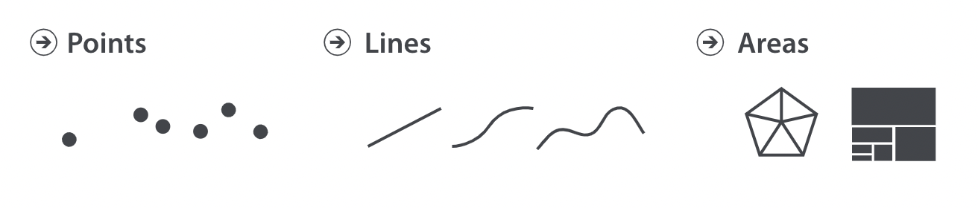
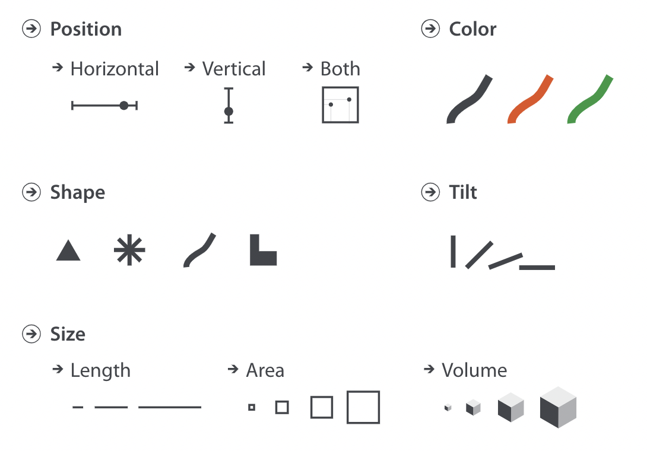
Visual Encoding
Marks
Channels
Notes:
As a recap, marks consist of points, lines, and areas, and channels consist of position, color, shape, tilt, and size.
We use marks to represent items in our datasets and we use channels to represent attributes.
For example, here is a snipped to a dataset about flights between different airports. Our items are each row, which is a specific flight, and we have a number of attributes. Such at tail_num, origin, dest., etc..
Let’s say we need to design a visual encoding for this dataset.

Slide 10
Visual Encoding
Marks
Channels
What are the marks and channels in this vis?
https://altair-viz.github.io/gallery/index.html
Notes:
As a recap, marks consist of points, lines, and areas, and channels consist of position, color, shape, tilt, and size.
We use marks to represent items in our datasets and we use channels to represent attributes.
For example, here is a snipped to a dataset about flights between different airports. Our items are each row, which is a specific flight, and we have a number of attributes. Such at tail_num, origin, dest., etc..
Let’s say we need to design a visual encoding for this dataset.

Slide 11
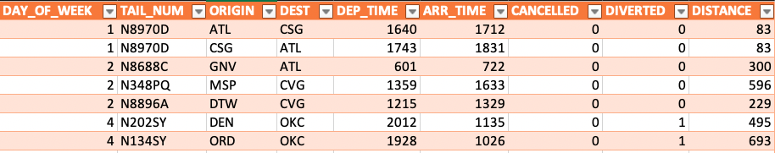
Visual Encoding
What are the items, attributes, and attribute types in this dataset?
https://www.kaggle.com/divyansh22/flight-delay-prediction/version/2
Notes:
As a recap, marks consist of points, lines, and areas, and channels consist of position, color, shape, tilt, and size.
We use marks to represent items in our datasets and we use channels to represent attributes.
For example, here is a snipped to a dataset about flights between different airports. Our items are each row, which is a specific flight, and we have a number of attributes. Such at tail_num, origin, dest., etc..
Let’s say we need to design a visual encoding for this dataset.

Slide 12
Visual Encoding
Items:
row (flight)
Attributes:
columns
ordinal
categorical
categorical
categorical
ordinal
ordinal
categorical
categorical
quantitative
https://www.kaggle.com/divyansh22/flight-delay-prediction/version/2
Notes:
As a recap, marks consist of points, lines, and areas, and channels consist of position, color, shape, tilt, and size.
We use marks to represent items in our datasets and we use channels to represent attributes.
For example, here is a snipped to a dataset about flights between different airports. Our items are each row, which is a specific flight, and we have a number of attributes. Such at tail_num, origin, dest., etc..
Let’s say we need to design a visual encoding for this dataset.

Slide 13
Visual Encoding
Items:
row (flight)
Attributes:
columns
ordinal
categorical
categorical
categorical
ordinal
ordinal
categorical
categorical
quantitative
Sketch a visual encoding that allows the user to check for a relationship between DAY_OF_WEEK and DISTANCE for these flights. Secondarily, your visual encoding should show the DEST and DIVERTED status of each flight.
https://www.kaggle.com/divyansh22/flight-delay-prediction/version/2
Notes:
As a recap, marks consist of points, lines, and areas, and channels consist of position, color, shape, tilt, and size.
We use marks to represent items in our datasets and we use channels to represent attributes.
For example, here is a snipped to a dataset about flights between different airports. Our items are each row, which is a specific flight, and we have a number of attributes. Such at tail_num, origin, dest., etc..
Let’s say we need to design a visual encoding for this dataset.

Slide 14
Visual Encoding
Marks:
points (item)
Channels:
DAY_OF_WEEK → horizontal position
DISTANCE → vertical position
DEST → shape
DIVERTED → color
https://www.kaggle.com/divyansh22/flight-delay-prediction/version/2
Notes:
First, we’ll need to pick appropriate marks and channels.
So let’s say we use points for each item
And let’s say based on a task analysis we did previously, the attributes we want to show are day of week, destination, diverted, and distance. We map each of these to an appropriate channel.

Slide 15
Visual Encoding
Marks:
points (item)
CSG
ATL
CVG
OKC
700
300
0
Channels:
DAY_OF_WEEK → horizontal position
DISTANCE → vertical position
DEST → shape
DIVERTED → color
Distance
Not Diverted
Diverted
1 2 3 4 5 6 7
Day of Week
https://www.kaggle.com/divyansh22/flight-delay-prediction/version/2
Notes:
Given this, we can now create a visual encoding for this data. Here we see day of week is on our x-axis, distance is on our y-axis, we’re showing destination with shape, and diverted with color.
Now this is great, but there’s a big step between identifying marks and channels and ending up with this scatter plot visualization.
So how exactly do we get from one to the other?

Slide 16
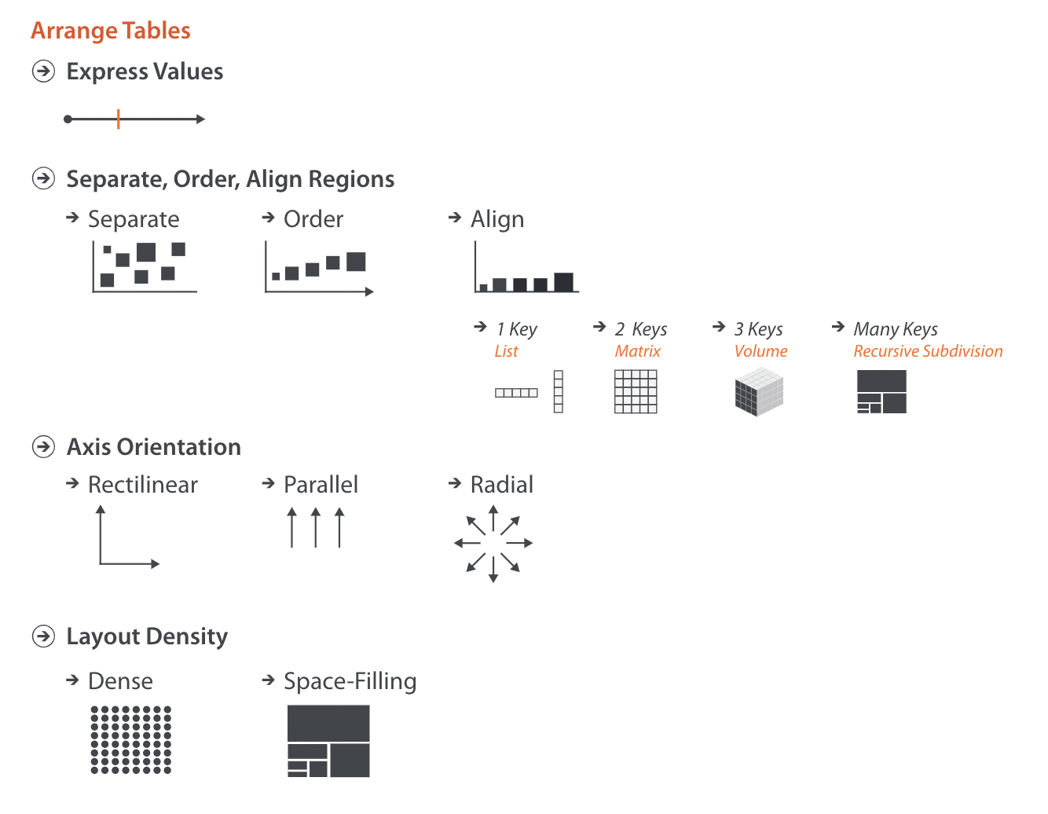
Arrange (tables)
Arrange (How will we use our most effective channels?)
Mapping quantitative attribute(s) to position channel
Mapping categorical attribute(s) to position channel
Choosing axes
Notes:
Well, the process for going from data to visual encoding is called arranging by Munzner. For now, we’re going to focus on Arranging specifically for tables.
The steps Munzner break this process into are:
Express values = showing quantitative attributes using position, amounts to mapping values to a spatial position along an axis
Separate, Order, Align regions = showing categorical attributes using position, drawing items from the same category in the same spatial region and deciding how to arrange those regions. Amounts to deciding how to separate items (according to a categorical attribute), and how to arrange and order those groupings (according to ordered or quantitative attributes)
Axis orientation = how will we align our axes
Layout density = is the layout dense or sparse, and is the layout space filling
Let’s take a closer look at each of these for the example we just created.

Slide 17
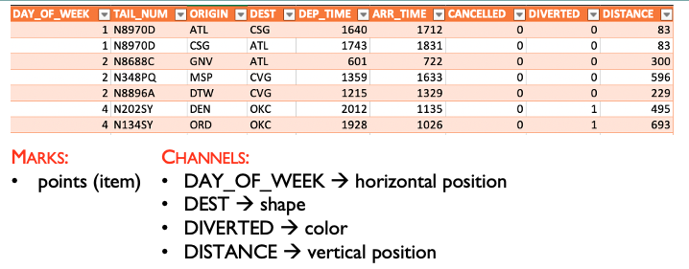
Arrange (tables)
Arrange
CSG
ATL
CVG
OKC
700
300
0
Distance
Not Diverted
Diverted
1 2 3 4 5 6 7
Day of Week
Notes:
First we have Express values = showing quantitative attributes using position, amounts to mapping values to a spatial position along an axis
For us, we took the quantitative variable we wanted to show, distance, and showed it using vertical position

Slide 18
Arrange (tables)
Arrange
CSG
ATL
CVG
OKC
700
300
0
Distance
Not Diverted
Diverted
1 2 3 4 5 6 7
Day of Week
Notes:
Next, we have Separate, Order, Align regions = showing categorical attributes using position, drawing items from the same category in the same spatial region and deciding how to arrange those regions. Amounts to deciding how to separate items (according to a categorical attribute), and how to arrange and order those groupings (according to ordered or quantitative attributes)
For us, we took our categorical or ordinal attribute, day of the week, and showed it using horizontal position.
Remember, position is our most effective channel. That means by using it to show Distance and Day of the Week we’re deciding those are the most important attributes for people to see when they use this visualization.

Slide 19
Arrange (tables)
Arrange
CSG
ATL
CVG
OKC
700
300
0
Distance
Not Diverted
Diverted
1 2 3 4 5 6 7
Day of Week
Notes:
Our third step, which we never explicitly stated, was deciding on an axis orientation. In this case, and in most cases, we used rectilinear axes.

Slide 20
Arrange (tables)
Arrange
Considerations for the arrange step:
Notes:
Now that we’ve gone through a specific example, let’s talk about walking through these arrange steps in general. In other words, what kind of information in our dataset can help guide our decision making process?

Slide 21
Arrange (tables)
Arrange
Considerations for the arrange step:
For tables, we arrange items by keys and values:
Key = an independent attribute(s) that can be used as a unique index to look up table items
→ Categorical or ordinal
Value = a dependent attribute, value in a specific cell
Notes:
Now that we’ve gone through a specific example, let’s talk about walking through these arrange steps in general. In other words, what kind of information in our dataset can help guide our decision making process?

Slide 22
Arrange (tables)
Arrange
Considerations for the arrange step:
For tables, we arrange items by keys and values:
Key = an independent attribute(s) that can be used as a unique index to look up table items
→ Categorical or ordinal
Value = a dependent attribute, value in a specific cell
Notes:
Now that we’ve gone through a specific example, let’s talk about walking through these arrange steps in general. In other words, what kind of information in our dataset can help guide our decision making process?

Slide 23
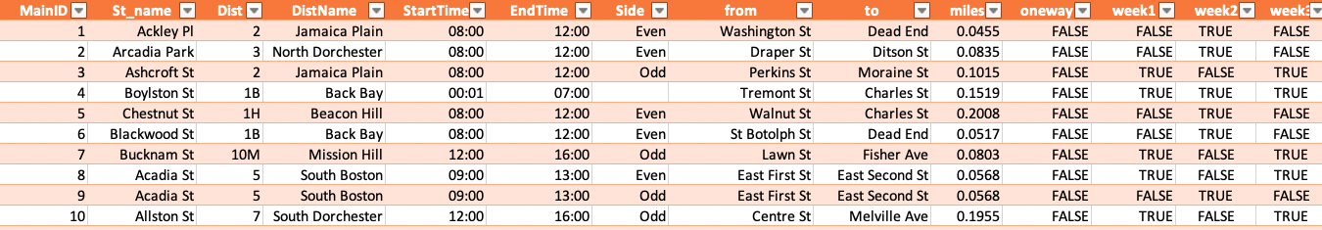
Arrange (tables)
Sketch a vis that supports the following task:
Compare start time of each street sweeping zone
https://data.boston.gov/dataset/street-sweeping-schedules/resource/9fdbdcad-67c8-4b23-b6ec-861e77d56227
Notes:
In this data set, what is our key? And what are our values?
Key = MainID
What does mainID / row represent? Street sweeping zone

Slide 24
Arrange (tables)
Sketch a vis that supports the following task:
Compare start time of each street sweeping zone
Value
Key
Key
Value
https://data.boston.gov/dataset/street-sweeping-schedules/resource/9fdbdcad-67c8-4b23-b6ec-861e77d56227
Notes:
In this data set, what is our key? And what are our values?
Key = MainID

Slide 25
Arrange (tables)
One key (list alignment)
Key
Value
Express Values
StartTime
MainID
Separate, order, align (by key)
Bar Chart
Notes:
Other times, our tables will include key values that are important to communicate.
In these cases, we need to separate, order, and align regions of our data.
We do this with respect to keys. Specifically, we separate the items in our tables into regions according to which key or set of keys identify the item and then we decide how to order and align those regions.
When we’re working with only one key, our items each get separated into their own unique region and we call this list alignment.
An example of a visual encoding we use when we’re working with one key and the next most important attribute for us to communicate is quantitative is a bar chart.
Notice that here each bar corresponds to one key (in other words, each region of our data is represented by a bar), and then align our regions along the X-axis using position to communicate our different key values. And finally, we decide if and how we want to order our regions. If your key is categorical your ordering may be arbitrary, but if your key is ordinal, your ordering will likely match the ordering of levels of your key.
<next>

Slide 26
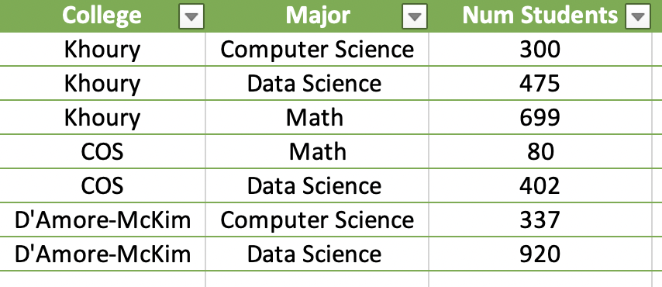
Arrange (tables)
Sketch a vis that supports the following task:
Compare number of students for each major and college
Notes:
How about this table?
Key = College+Major -- sometimes we need to combine attributes to get unique keys

Slide 27
Arrange (tables)
Sketch a vis that supports the following task:
Compare number of students for each major and college
Value
2 Keys
Key
Key
Value
Notes:
How about this table?
Key = College+Major -- sometimes we need to combine attributes to get unique keys

Slide 28
Arrange (tables)
Two keys (multi-dimensional table)
Separate, order, align (by key)
Key
Key
Value
Express Values
Num Students
College
Separate, order, align (by key)
Major
Stacked Bar Chart
Notes:
Next, let’s talk about some visual encodings we can use when we have two keys, or a multi-dimensional table.
If one key is ordinal or categorical and the other is categorical one thing we can do is represent out data with a stacked bar chart. <explain bar chart>
Question: if both keys are categorical, how should I decide which is represented by position on the x-axis and which is represented with color of bars?

Slide 29
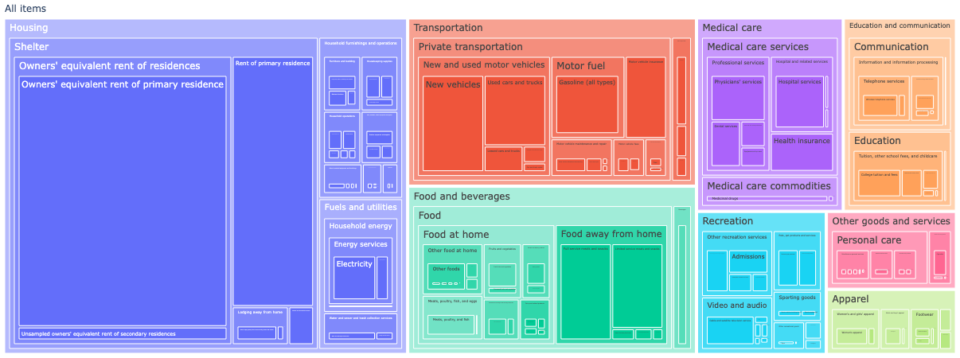
Arrange (tables)
Note: we can also have more than two keys
Key
Key
Key
Key
Separate, order, align (by key)
https://cloud.datapane.com/reports/Y3YLZzA/visualizing-deeply-nested-data/
Notes:
There are of course more options for showing data with one key, two keys, or more than 2 keys. I’m going to leave looking at those as part of your homework for this week. For now, we’re going to switch into our next consideration for arranging table data
Note that this is a case too where we don’t necessarily align our regions along an axis, instead we align them with respect to hierarchy.

Slide 30
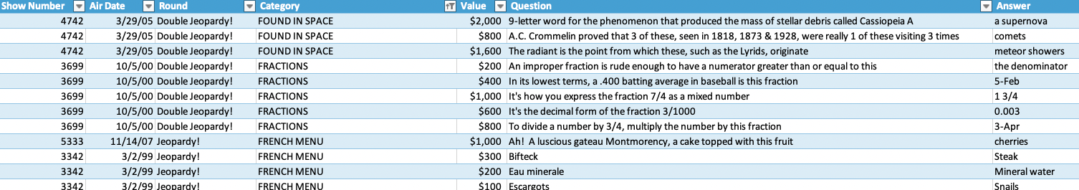
Arrange (tables)
Sketch a vis that supports the following task:
Look for a relationship between air date and question value
https://domohelp.domo.com/hc/en-us/articles/360043931814-Fun-Sample-DataSets
Notes:
How about this table?
Key = No key! This happens sometimes, and that’s okay

Slide 31
Arrange (tables)
Sketch a vis that supports the following task:
Look for a relationship between air date and question value
Value
Value
Value
Value
https://domohelp.domo.com/hc/en-us/articles/360043931814-Fun-Sample-DataSets
Notes:
How about this table?
Key = No key! This happens sometimes, and that’s okay

Slide 32
Arrange (tables)
No key
Value
Value
Express Values
Value
Air Date
Express Values
Scatter Plot
Notes:
Sometimes we have no Keys, or two quantitative values are the most important attributes for us to show.
In cases like this, we just need to express values, which amounts to using position along an axis to communicate values.
An example visual encoding you would use in this case is a scatter plot. Scatter plot are a visual encoding we use when the two most important attributes to communicate are quantitative, and we want to show a relationship (or lack thereof) between them.

Slide 33
Arrange (tables)
Arrange
Mapping quantitative attribute(s) to position channel
Mapping categorical attribute(s) to position channel

Slide 34
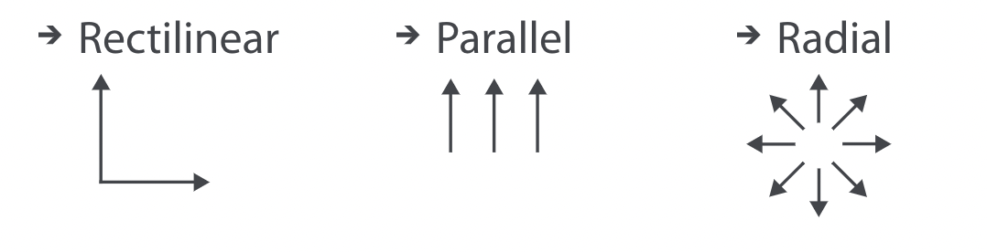
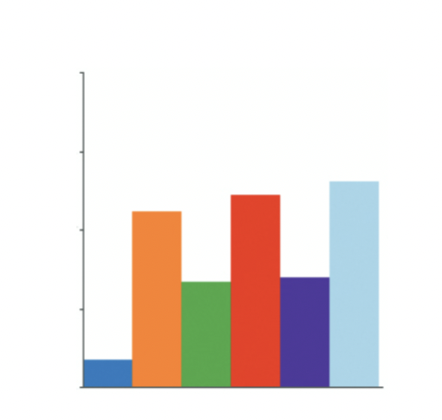
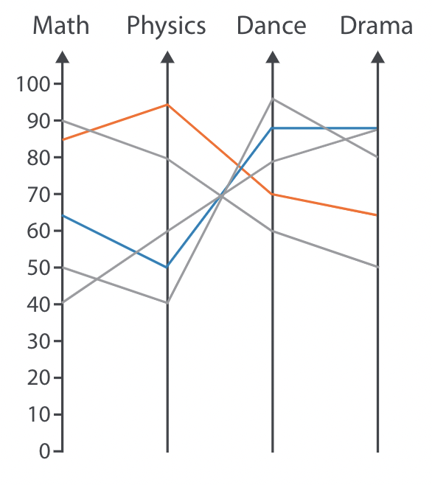

Arrange (tables)
Axis Orientation
Parallel Coordinates
Plot
Bar Chart
Radial Bar Chart
Notes:
The first additional point we consider is axis orientation. And there are three different options.
Rectilinear is what we’re probably all used to. It’s just using cartesian coordinates.
Parallel axes are when we arrange each axis as parallel to the others.
Radial is when we use polar coordinates to make plots.
Let’s look at some examples.

Slide 35
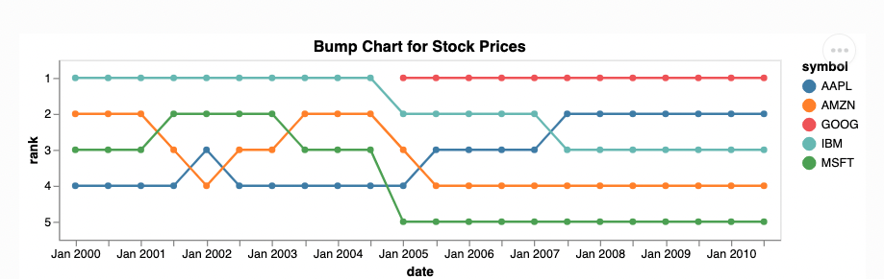
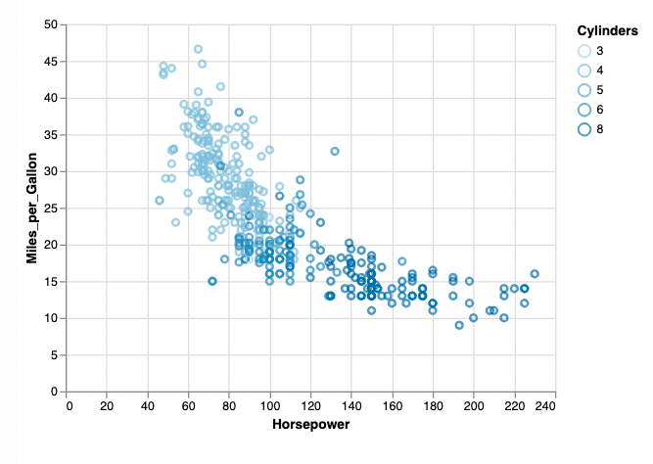
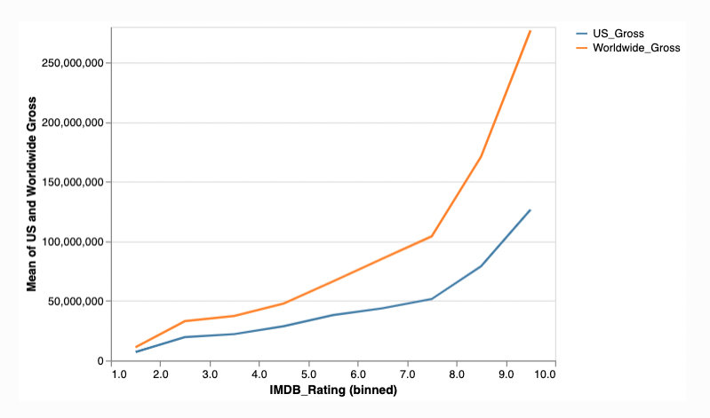
Arrange (tables)
Axis Orientation
Bar Chart
https://altair-viz.github.io/gallery/index.html

Slide 36
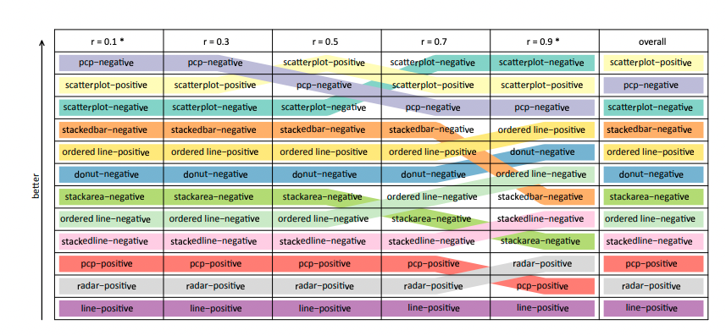
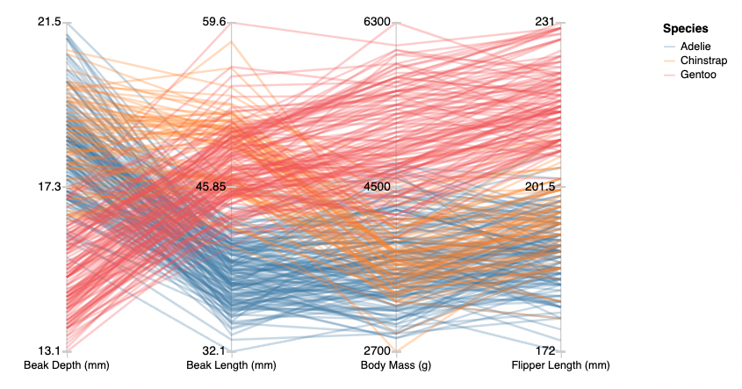
Arrange (tables)
Axis Orientation
https://visualthinking.psych.northwestern.edu/publications/Harrison-weberlaw-infovis2014.pdf
Parallel Coordinates
Plot
https://vega.github.io/vega-lite/examples/parallel_coordinate.html
Notes:
Penguins

Slide 37
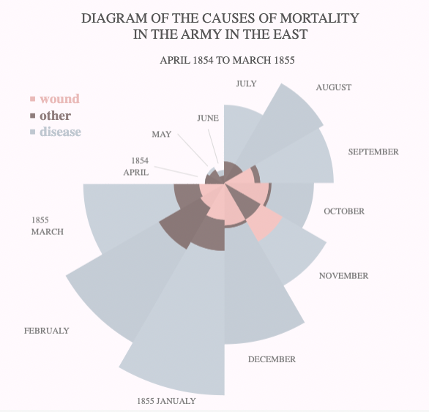
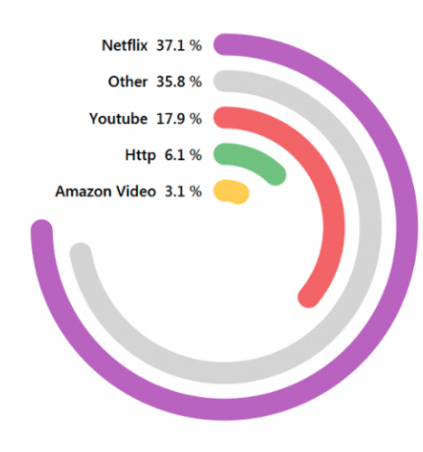
Arrange (tables)
Axis Orientation
https://tableau.toanhoang.com/radial-bar-chart-tutorial/
Radial Bar Chart
https://public.tableau.com/app/profile/satoshi.ganeko/viz/NaichingaleDiagram/Diagram

Slide 38
Arrange (tables)
Arrange
Mapping quantitative attribute(s) to position channel
Mapping categorical attribute(s) to position channel
Choosing axes

Slide 39
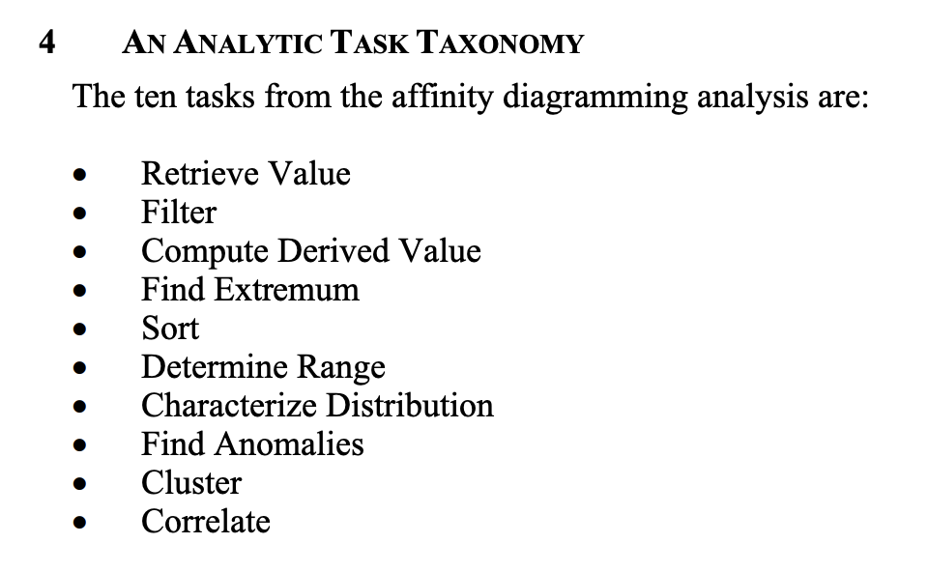
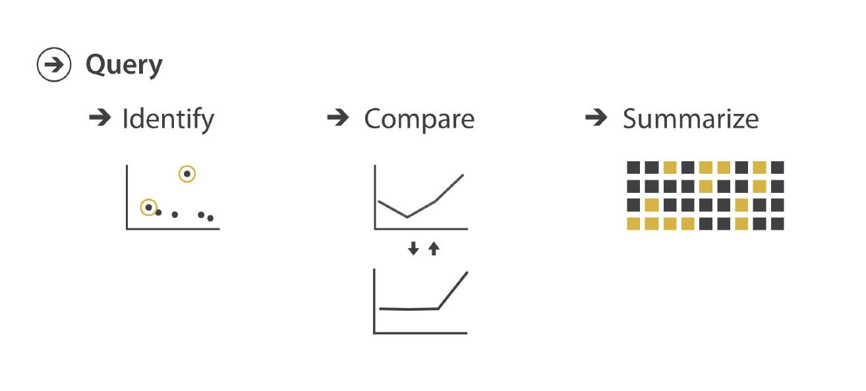
Visual Encodings and Tasks
Low-level tasks:
More granular visualization tasks:
Amar et al. Low-level components of analytic activity in information visualization
https://datavizproject.com/#

Slide 40
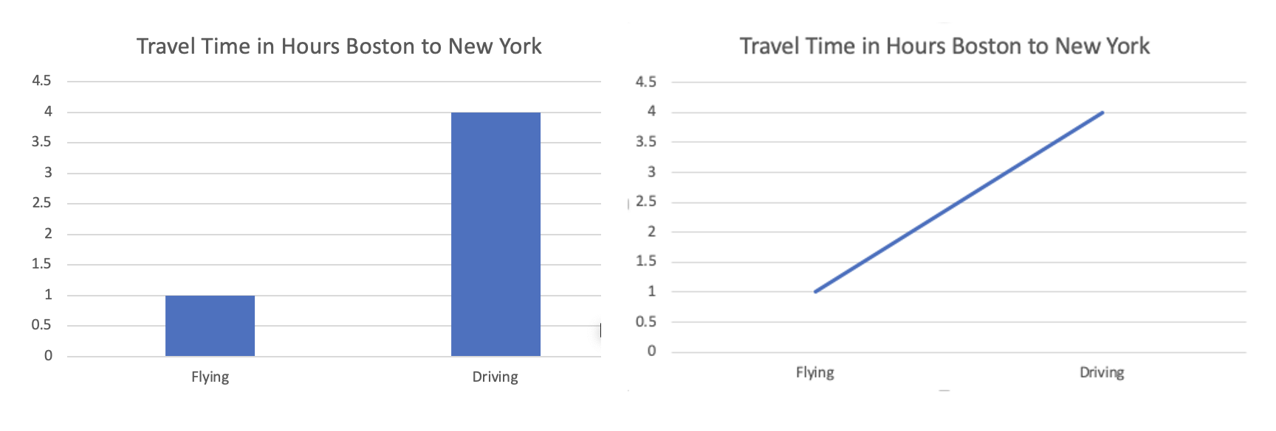
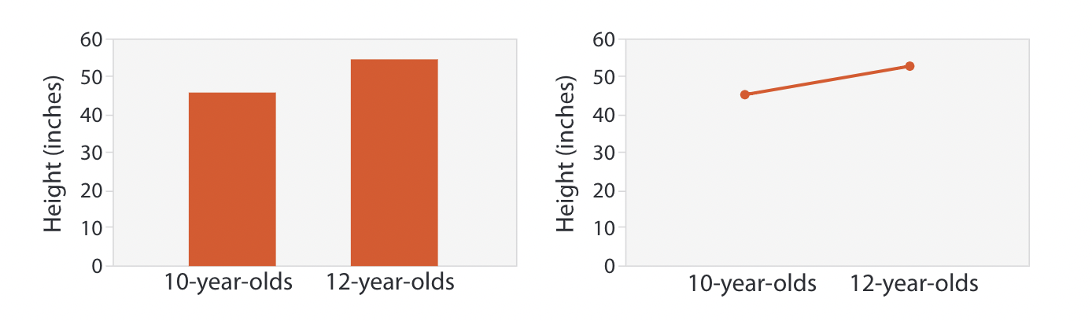
Visual Encodings and Tasks
Be aware of the attribute type of your key and what your visualization communicates
Key (categorical)
Key (ordinal)
Notes:
Talk about interpretation of each chart and when it makes sense.
This is an example of why it is important to consider tasks and data as we create our visual encodings. Otherwise, we can end up communicating things we do not intend to communicate.

Slide 41
Visual Encodings and Tasks
Work in pairs to sketch two visual encodings that would be good for your assigned task.
More granular visualization tasks:
Amar et al. Low-level components of analytic activity in information visualization
https://datavizproject.com/#

Slide 42
Let’s take a break! Stretch, go for a walk, be social ☺ Be back here in 10 mins.

Slide 43
Sketching New Visualizations

Slide 44
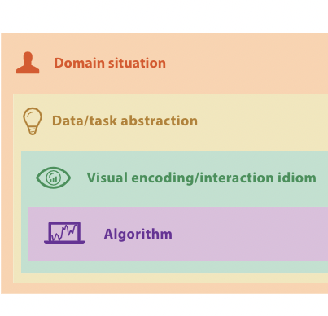

Human-Centered, Iterative Design
Human-Centered, Iterative Design
Design
Evaluate

Slide 45
Human-Centered, Iterative Design
Ground our designs in human needs
Gather an understanding of the domain situation from our end users
Check our work by iterating, i.e. continually verifying and evaluating our proposed visualization tool

Slide 46




Task/Data Abstraction → Visual Encoding
Look at the tasks you need to support
Identify Visual Encodings that support those tasks and work with your attribute types
→ Ex. Bar chart vs. line chart, bar chart vs scatter plot
VS
VS
Quantitative vs. Categorical
Quantitative vs Quantitative
Comparison
Trend
Notes:
Specifically, what we need to do to design a new visualization is to

Slide 47
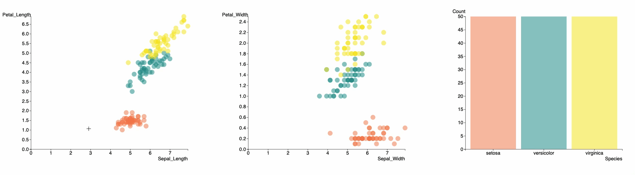
Task/Data Abstraction → Visual Encoding
Think about linking tasks together (i.e. coordinating multiple visual encodings)

Slide 48
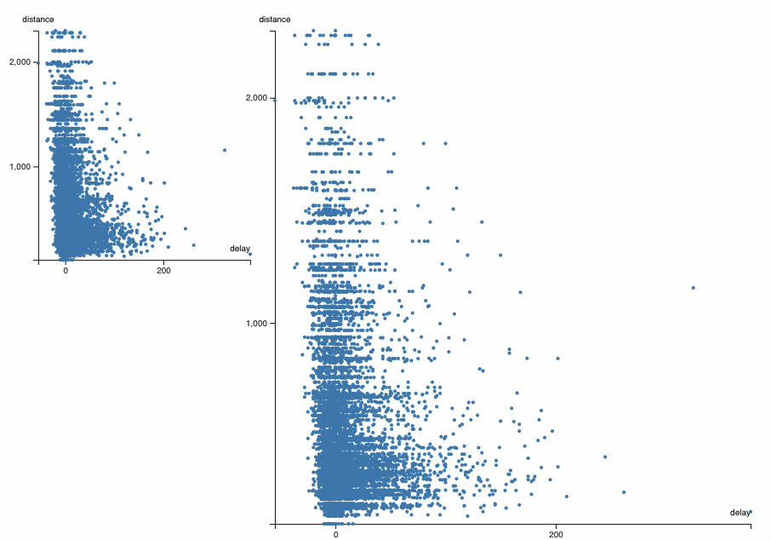
Task/Data Abstraction → Visual Encoding
Think about linking tasks together (i.e. coordinating multiple visual encodings)
https://observablehq.com/@berkeleyvis/d3-coordinated-views

Slide 49
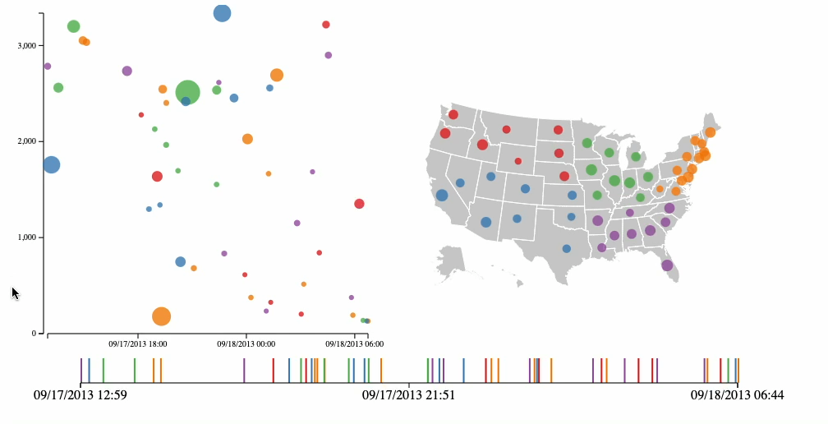
Task/Data Abstraction → Visual Encoding
Think about linking tasks together (i.e. coordinating multiple visual encodings)
http://bl.ocks.org/dukevis/6768900

Slide 50
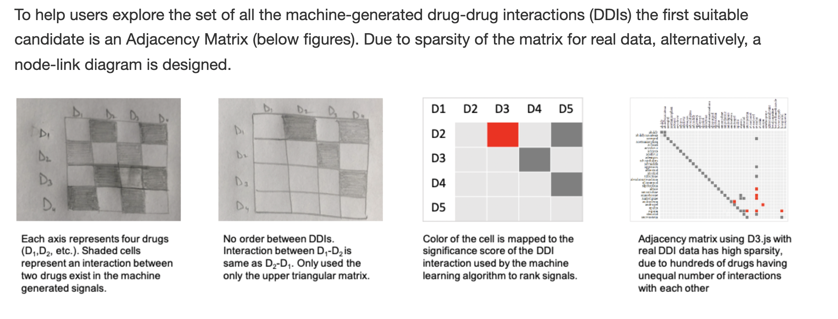
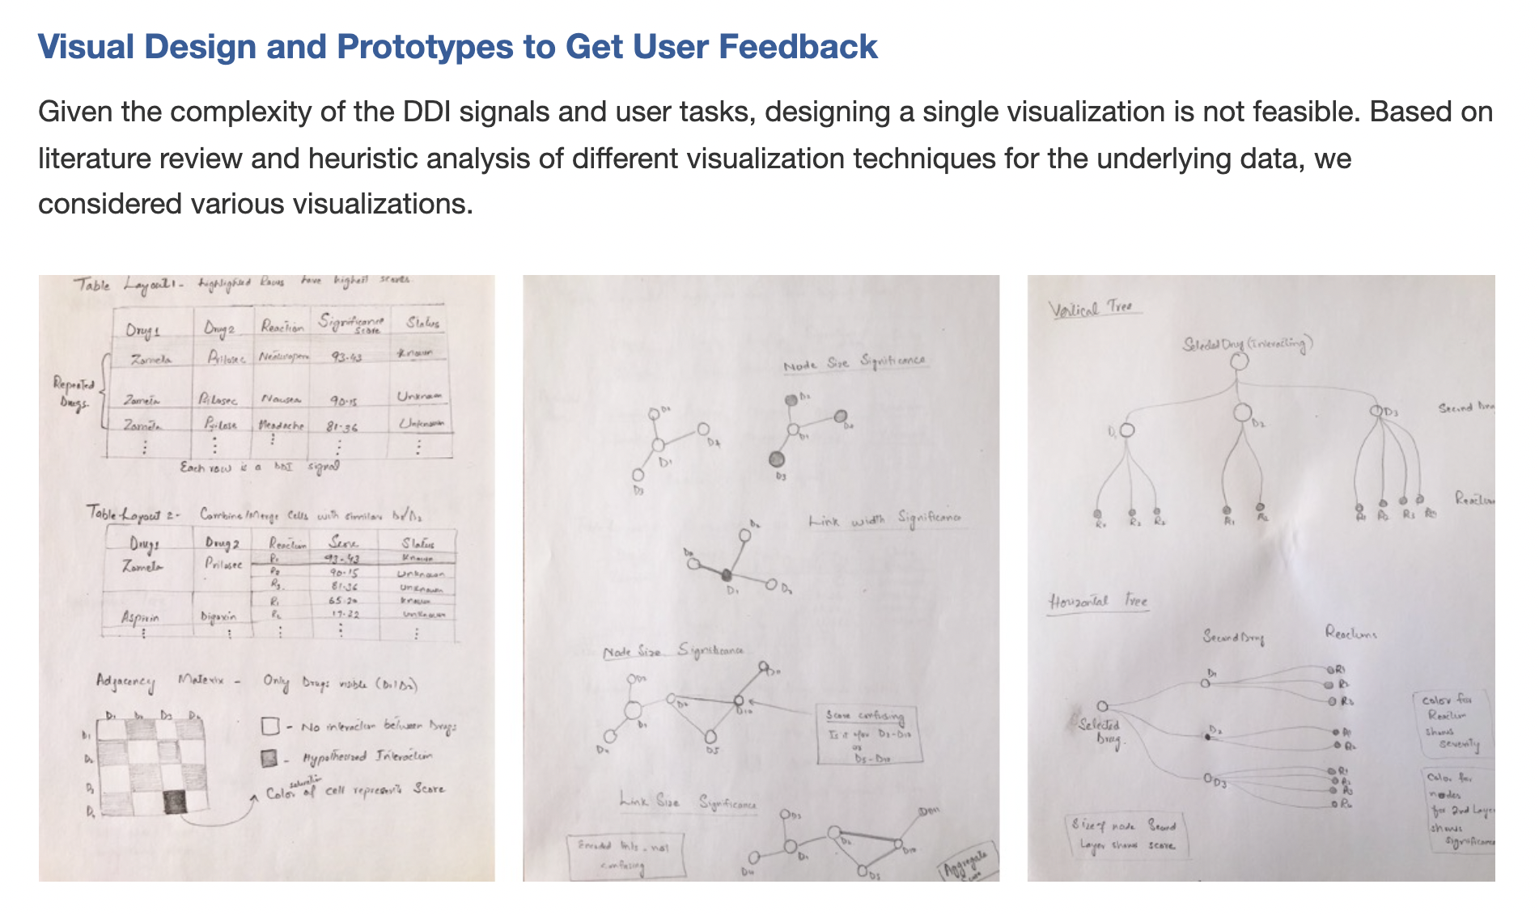
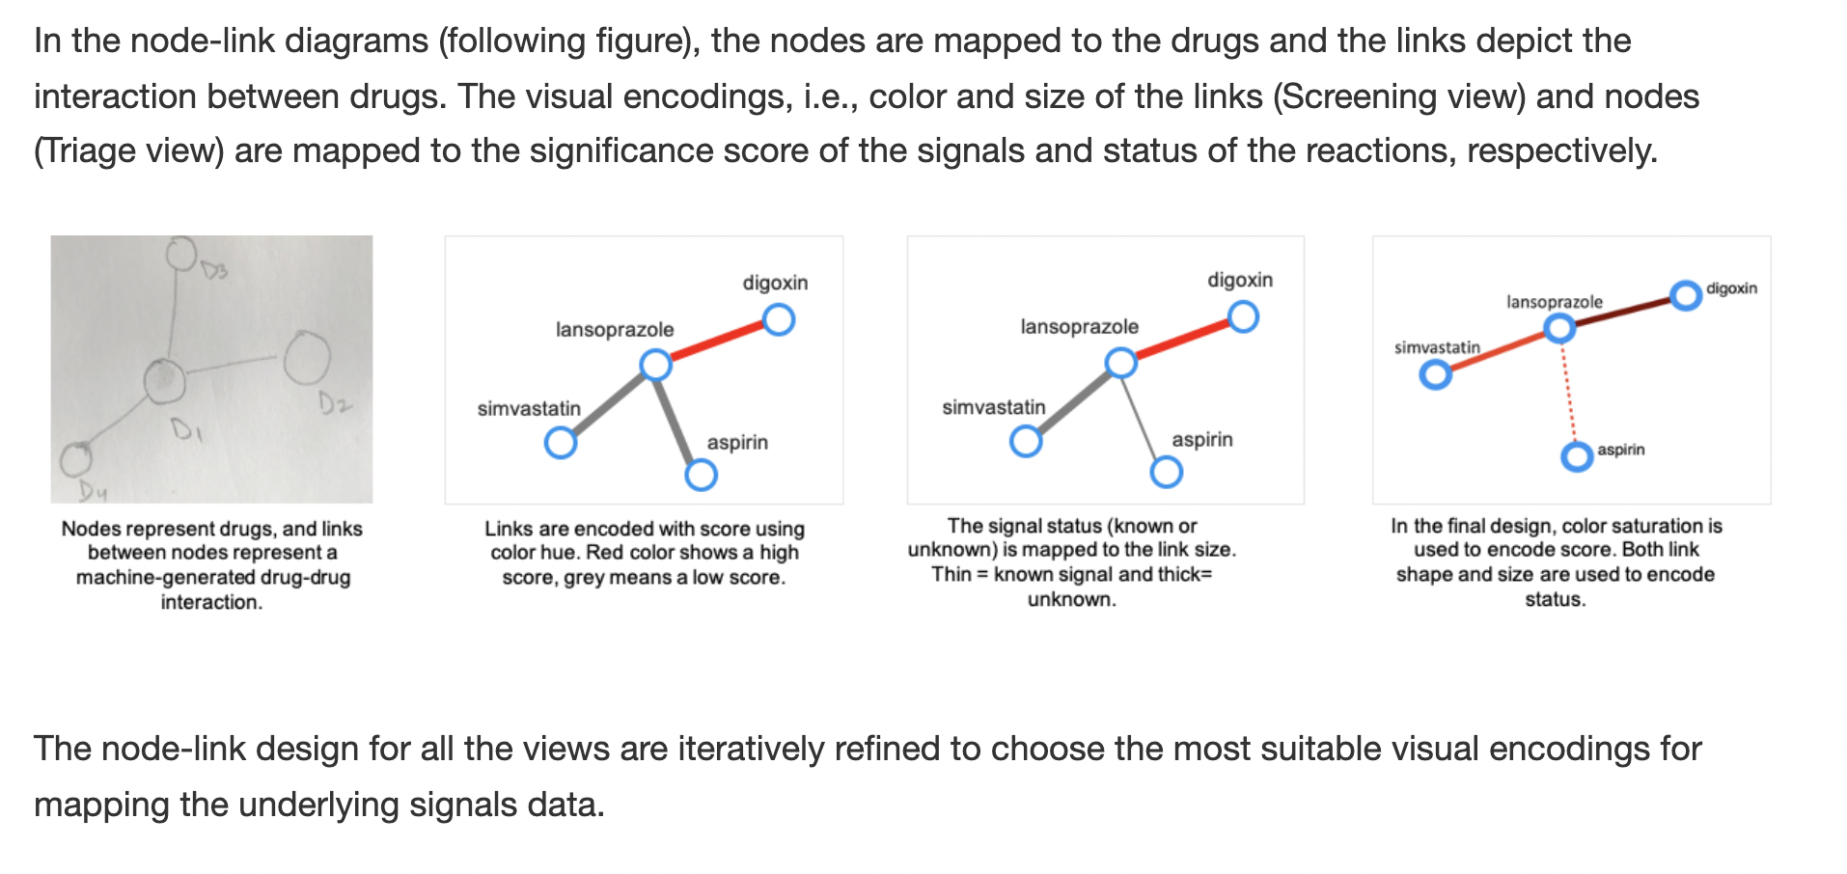
Task/Data Abstraction → Visual Encoding
Be creative & sketch, review, sketch
Ex. DIVA
https://tkakar.github.io/Website/DIVA.html
Notes:
And last, we sketch ideas! These can start as very rough sketches and will ultimately be refined into polished digital sketches.
Note move from hand drawn to digital

Slide 51
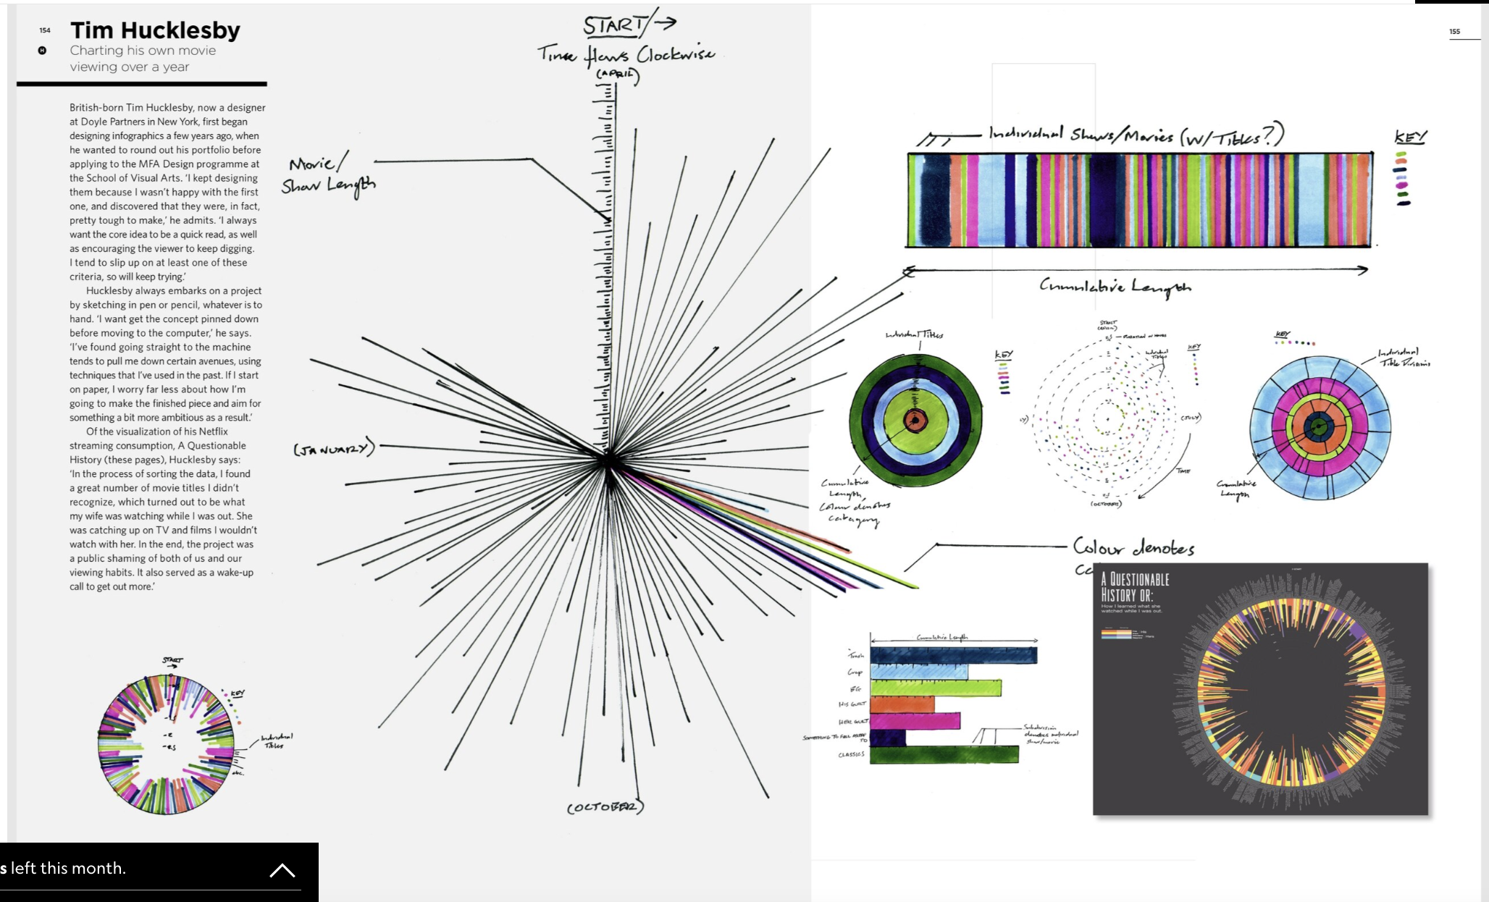
Task/Data Abstraction → Visual Encoding
Be creative & sketch, review, sketch
https://www.nationalgeographic.com/science/article/2015704-datapoints-sketching-data
Notes:
And last, we sketch ideas! These can start as very rough sketches and will ultimately be refined into polished digital sketches.
Note move from hand drawn to digital

Slide 52
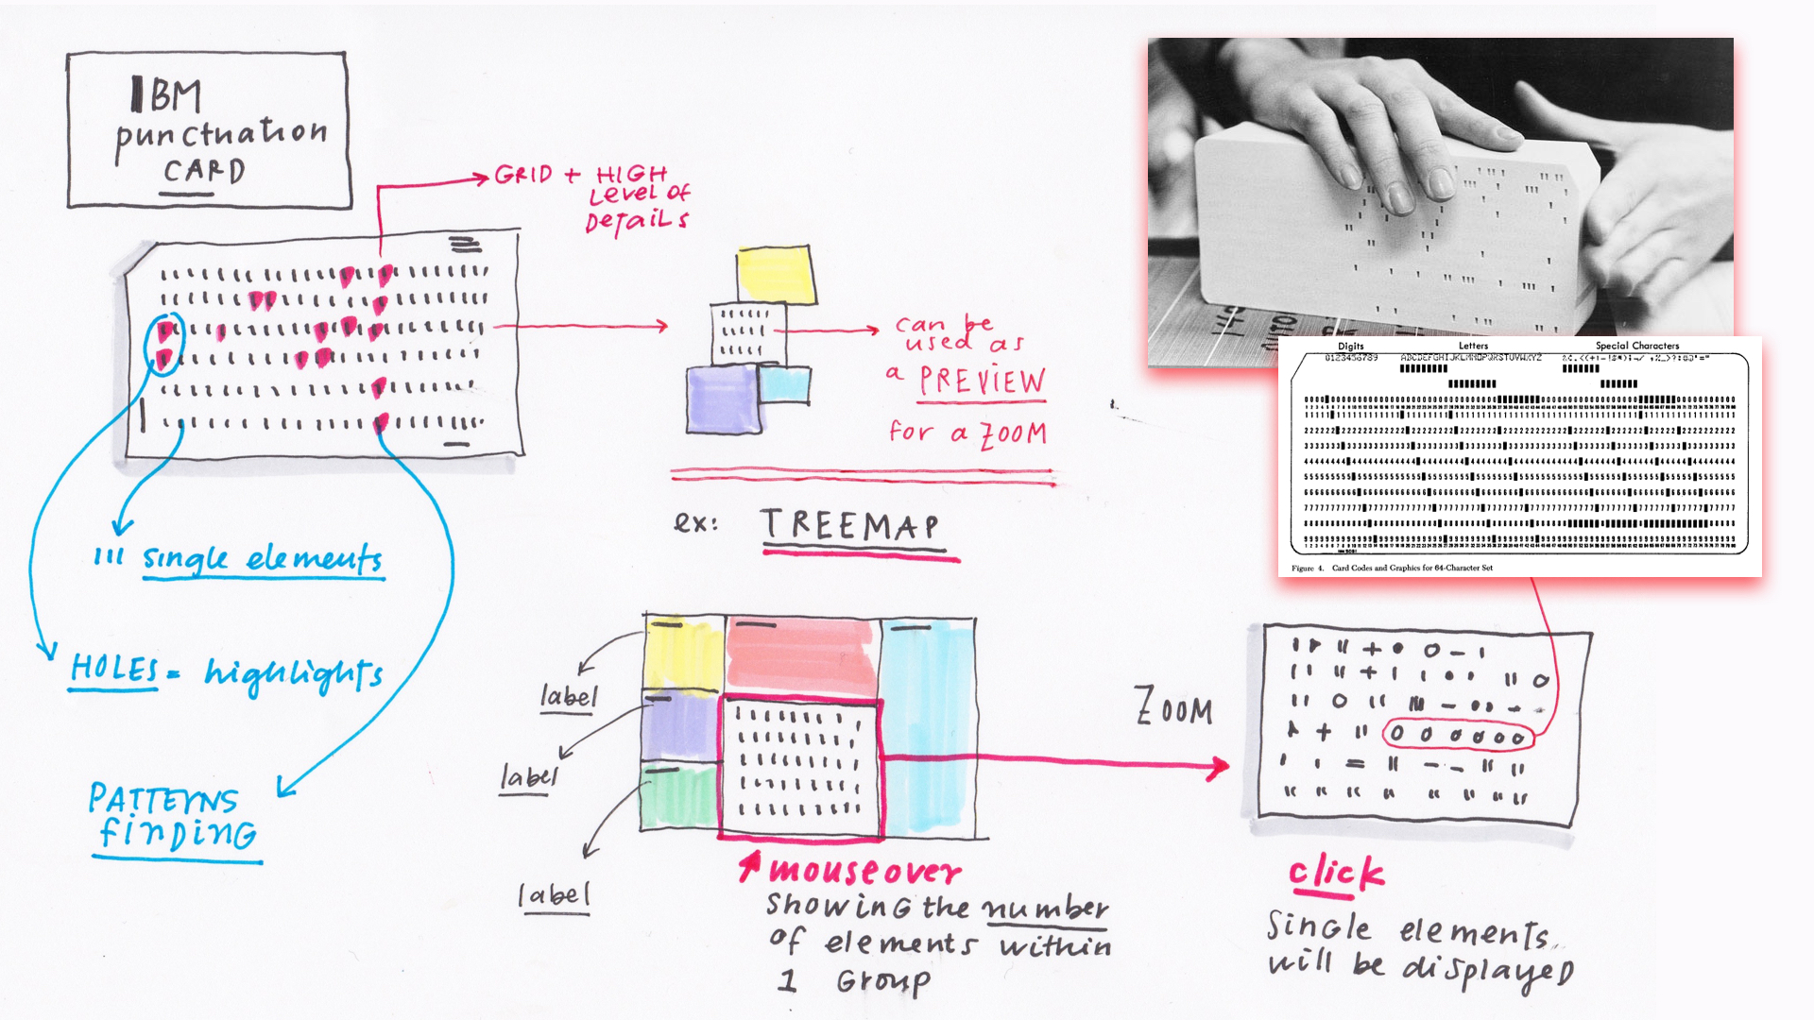
Task/Data Abstraction → Visual Encoding
Be creative & sketch, review, sketch
http://giorgialupi.com/be-ibm-with-data
Notes:
And last, we sketch ideas! These can start as very rough sketches and will ultimately be refined into polished digital sketches.
Note move from hand drawn to digital

Slide 53
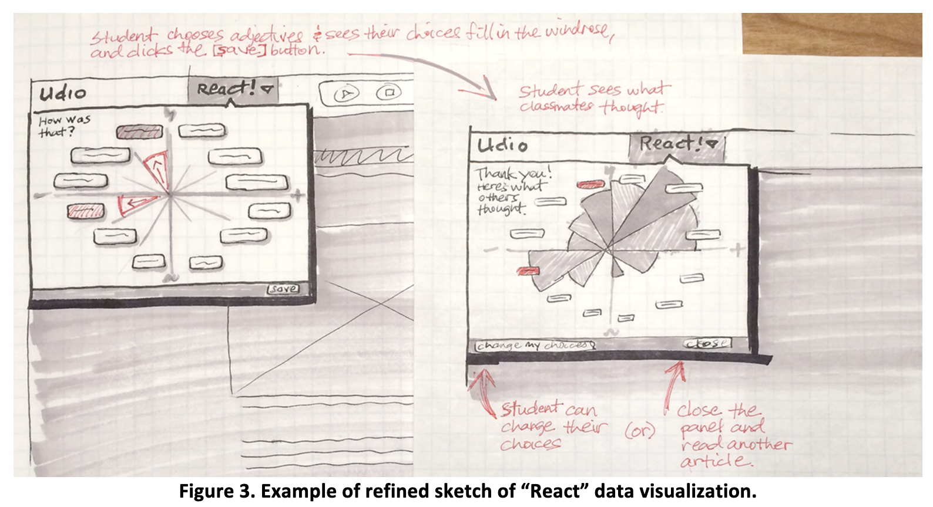
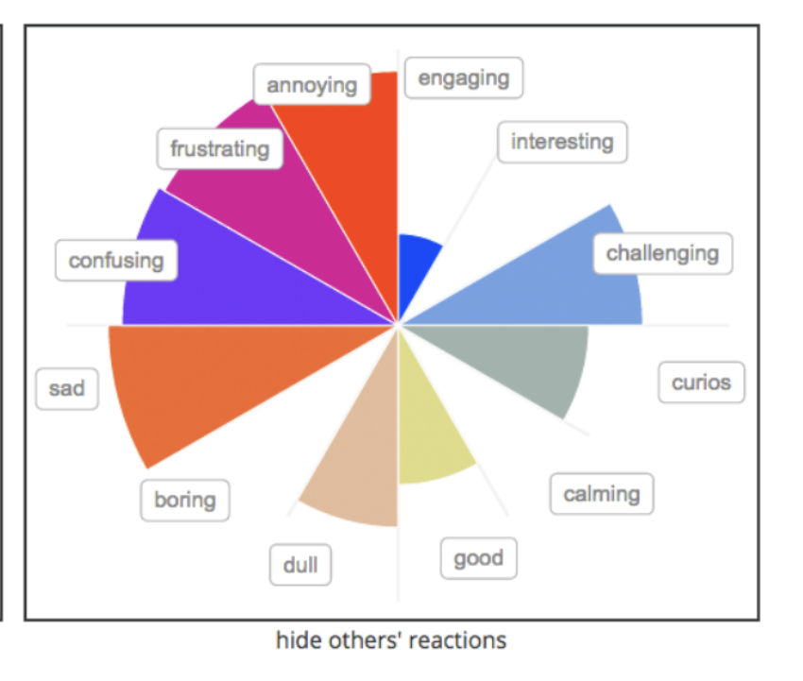
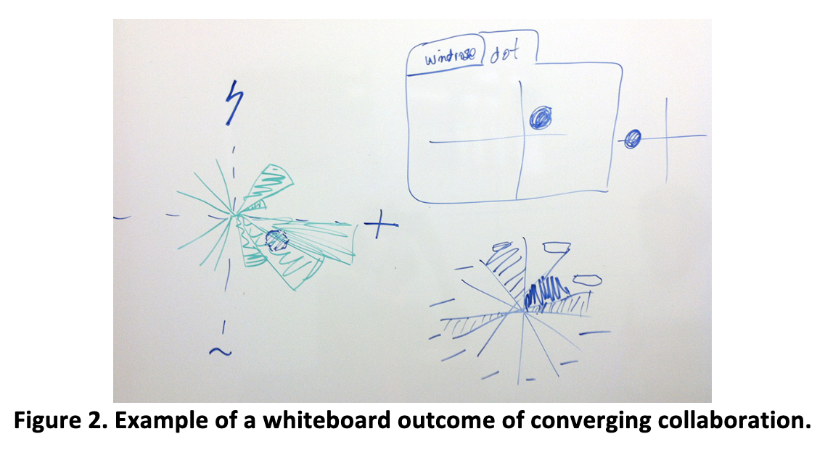
Task/Data Abstraction → Visual Encoding
Be creative & sketch, review, sketch
Hillaire et al. Prototyping Visual Learning Analytics Guided by an Educational Theory Informed Goal
Notes:
And last, we sketch ideas! These can start as very rough sketches and will ultimately be refined into polished digital sketches.
Note move from hand drawn to digital

Slide 54
Summary
Today we:
Reviewed arranging visual encodings for tables
Reviewed iterative design / sketching new visualizations
ic-09 is DUE today.
hw-05 is DUE before next class.

